Slide 1
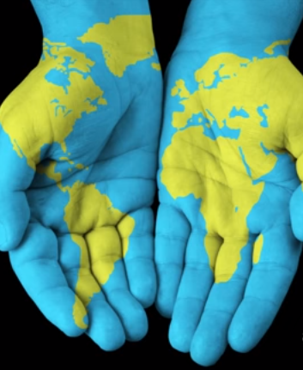
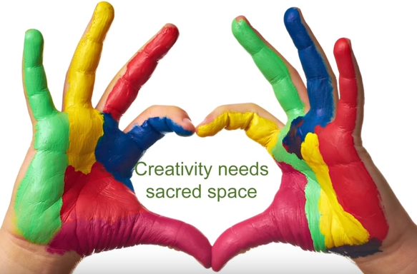
Creativity & Business Plans
Presented By
Dr. M. Tariq Yousafzai

Slide 2
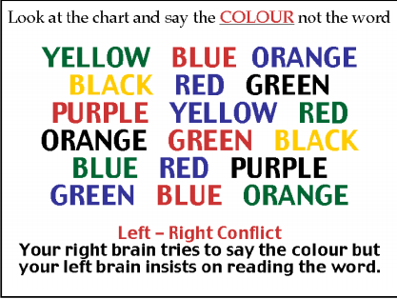

Slide 3


Slide 4
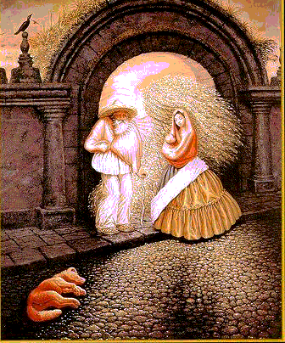
Check your perception? (idea and opportunity)

Slide 5
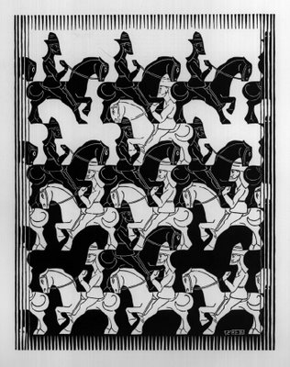

Slide 6

Can you See Creativity?
What is creativity to you?
Can you see it out there?
Can you Show it?
Do you have what it take to be a creative person?
I mean tool box, sacred space, obsession
Creativity is like wind. You cannot see it but actually feel it!
Serendipity: the occurrence and development of events by chance in a happy or beneficial way.

Slide 7
Creativity Defined
“Novelty that is useful.” - Stein
Ability to produce work which is both novel and appropriate
Creativity requires concept clarity.

Slide 8
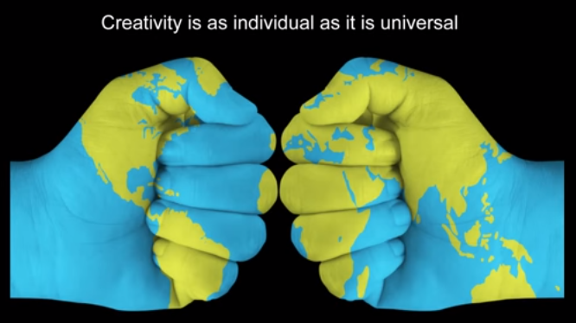

Slide 9
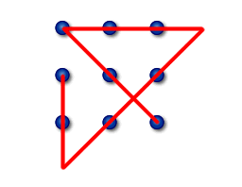
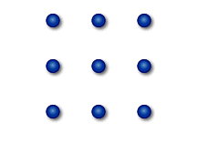
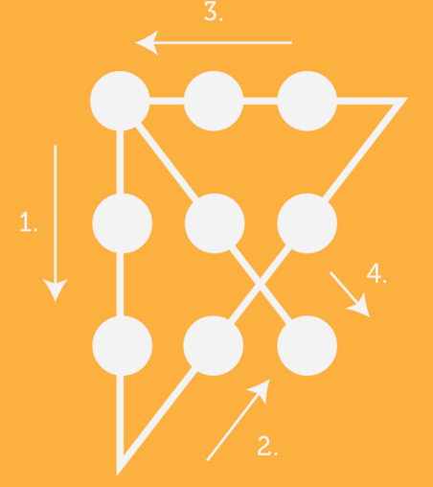
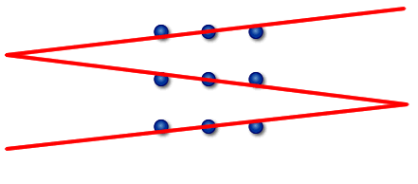
Thinking outside the Box

Slide 10
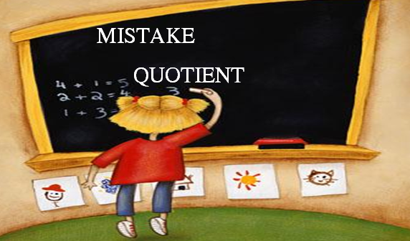
Creativity needs mistakes
Remarkable silence
Average American buys 17 books a year
Toughen yourself..take a cold shower
Everybody wants but everybody is not willing to toughen up for a good life
A moment of sudden and great revelation or realization.
Creativity is a matter of skill, talent and personality.

Slide 11
Importance of Mentors
Too soon old or too late smart
I didn’t want to be the richest man in the graveyard
Socrates-Plato and Aristotle is also called gang of three with Palto a prized student of Socrates and Aristotle a prized student of Plato while Alexander the great had Aristotle as mentor
Bill gates had Paul Allen, Steve Jobs had Paul Wozinak
Warren buffet had Benjamin Grame

Slide 12
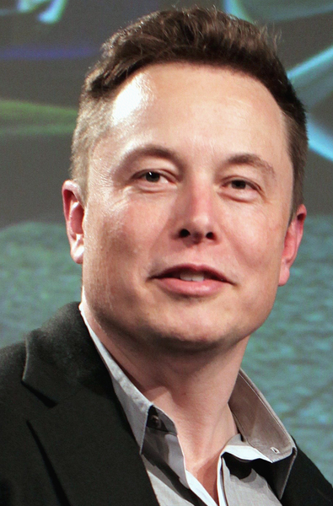
ELON MUSK
Born in 1971 South Africa
Self taught Programmer
Founder of Paypal
Building rockets from scratch
Sending Humans to Mars
Reads ten hours a day
Learns BASIC by finishing a 6 months course in 3 days
Worked odd jobs and stayed with relatives in canda.
Leaves stanford PhD after two years
Sleeps in office for 3 months
Merges with conformity forming PayPal and gets ousted as CEO of PayPal while on honey moon.
Learns how to build rockets from books
Thinks about building electric cars
Promises to send humans to Mars by 2021-2031

Slide 13
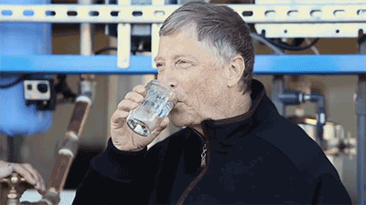

Slide 14
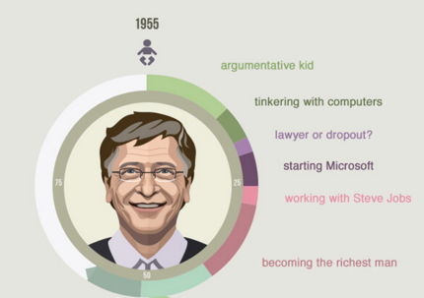
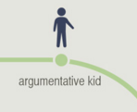
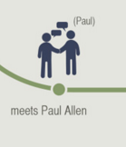

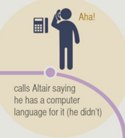
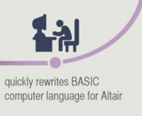
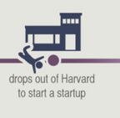

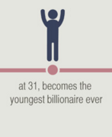
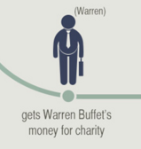
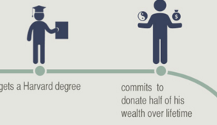
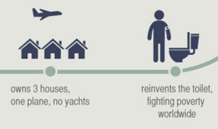

Slide 15
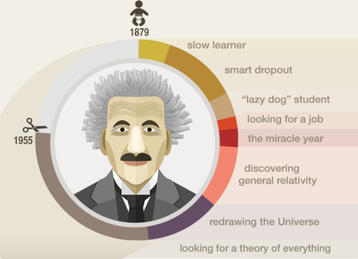
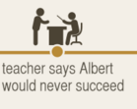

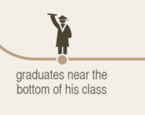
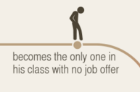

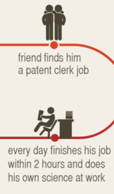
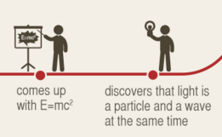
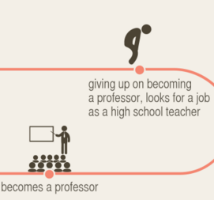
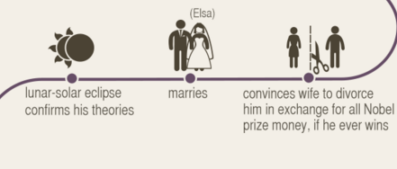
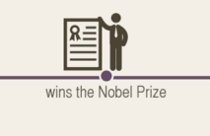


Slide 16
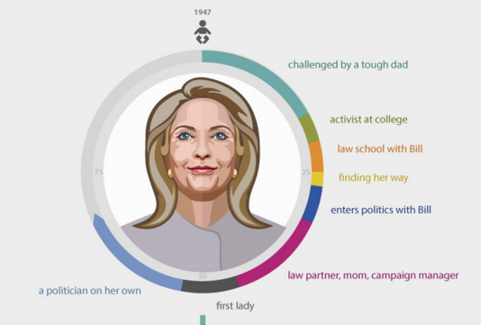
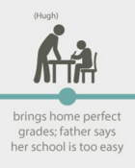

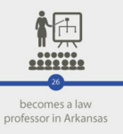
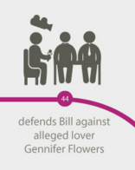
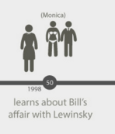
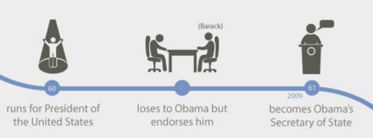
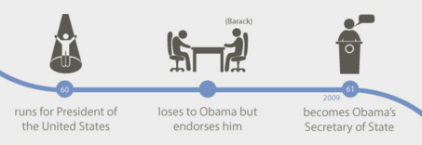
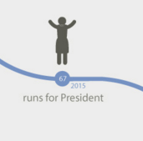
.

Slide 17
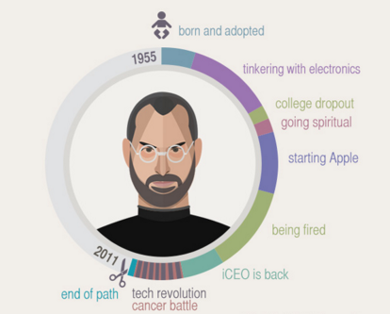
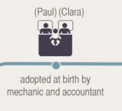
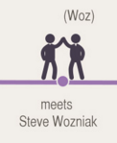

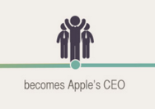

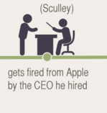
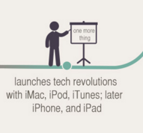
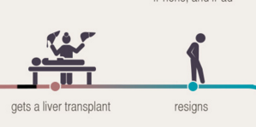
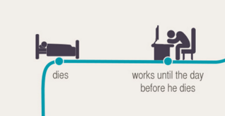

.

Slide 18
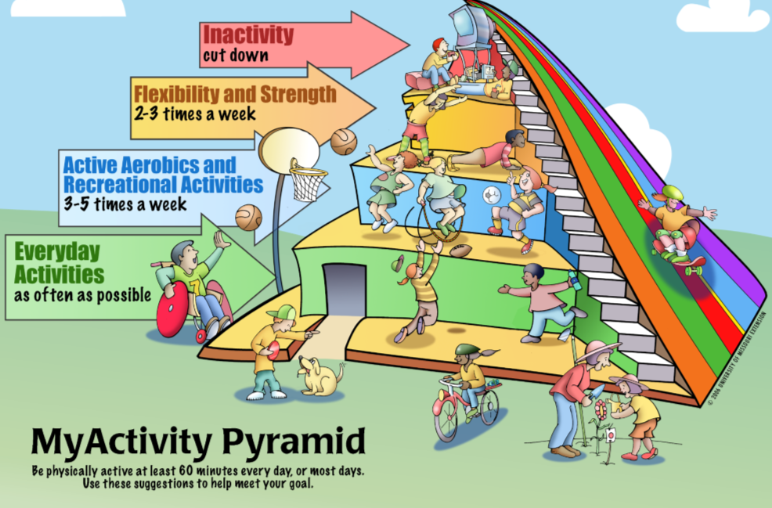

Slide 19
Creativity inhibitors
Personal
Fear!!!
Inability to tolerate uncertainty
Values: conformity
Self-image (low self-efficacy)
Problem-solving: inappropriate cognitions
Rigid thinking
Premature judgment
Impaired ability to see alternatives
Environmental
Resistance to new ideas
Autocratic leadership
Remuneration system
Cultural idiosyncrasies

Slide 20
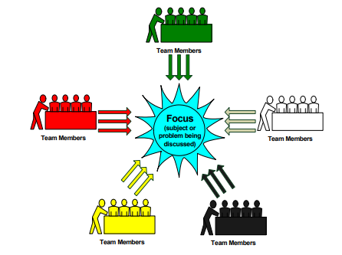
Edward de Bono’s Six Thinking Hats
AN AID TO DECISION MAKING AND PROBLEM SOLVING.
Notes:
Deans Apartments and our friend building apartments near university of Peshawar. Missed the idea of Economies of scale
RBG: Red Blue and Green
If people would know the price of dead bodies..they probably would not burry their deceased.. PMDC requires 25 skulls for accreditations.
Red Hat: Fire and Warmth. Associated with emotions, Hunches, Gut and feelings
Yellow Hat: Think of sun shine, optimism, logical and positive thinking
Black Hat: Think of a stern judge, It is a hat of critic, Logic, analyst, negative
Green Hat: Think of vegetation and rich growth, This is the hat for creative possibilities and ideas
White Hat: Think of white paper, It covers facts, neutral and objective information
Blue Hat: Think of the sky and overview, Associated with agenda, process, organizer and decision
Allows a switch in thinking without threatening ego.
KILL YOUR EGO..EGO IS THE BIGGEST PROBLEM… NAAK KA MALSA HAI..KHATARNAAK..DEHSHAK NAAK….SHARAM NAAK..AFSOOS NAAK..
FOR EXPERIENCE THERE IS NO SUBSTITUTE

Slide 21
Edward de bono Six thinking hats
Traditional thinking is 2400 years old, based on the philosophies of Socrates, Plato and Aristotle
– Socrates used to point out ‘what was wrong’ to clarify the concepts
– Plato believed that we can see only shadows of truth as we go through life
– Aristotle believed that people would put together different ‘boxes’ in their mind based on their experience & judge things into one of those boxes.
This is good in a static world but not in a dynamic one.

Slide 22
Six Thinking Hats
Informative
Intuitive
Constructive
Creative
Reflective
Cautious

Slide 23


Thinking is a skill, that is all about using what you’ve got

Slide 24
Thinking is a skill, that is all about using what you’ve got
An excellent driver will get great
performance, even out of a banger.

Slide 25
Thinking is a skill, that is all about using what you’ve got
A poor driver won’t get a good
perfomance out of a great car.
An excellent driver will get great
performance, even out of a banger.

Slide 26
Six Thinking Hats
Lateral thinking is a concept Edward de Bono developed to avoid the vicious circle of “Digging the same hole deeper.”
Allows for parallel thinking (lateral thinking).
De Bono sees thinking as a skill and we must improve upon this ability.
Through his technique meeting time is reduced
One thing at a time approach. Everything at once creates confusion.
One thing at a time (thinking about) allows us direction and focus.
Notes:
When you are stuck I n a hole. The first rule of the hole is then to stop digging

Slide 27
Six thinking hats
Allows us to have full view of the subject. Just like a frame
It takes us from argument mode to cooperative constructive thinking
Six hats are not categories of people
They are like gears of a car. A driver should be able to use all gears. (Use all your mental faculties)

Slide 28
Lateral Thinking
Allows us to design solutions
Israel and Gaza
They when invited to think responded
We are not here to think. We are here to represent our countries.
Lateral thinking is deliberate creativity
It also permits us to control people who insist of sticking to one perspective - we can ask them to assume a different hat
Many major international organisations use this technique for problem solving

Slide 29

The Six Thinking Hats
Managing the Thinking
Setting the focus
Making summaries
Overviews & conclusions
Action Plans
Blue Hat
FOCUS

Slide 30

The Six Thinking Hats
Managing the Thinking
Setting the focus
Making summaries
Overviews & conclusions
Action Plans
Black Hat
Blue Hat
Why it may not work
Cautions * Dangers
Problems * Faults
Logical reasons
must be given
FOCUS

Slide 31

The Six Thinking Hats
Managing the Thinking
Setting the focus
Making summaries
Overviews & conclusions
Action Plans
Black Hat
Blue Hat
Why it may not work
Cautions * Dangers
Problems * Faults
Logical reasons
must be given
FOCUS
Feelings and Intuition
Emotions and hunches
No reasons or justifications
“At this point”
Keep it short
Red Hat

Slide 32

The Six Thinking Hats
Managing the Thinking
Setting the focus
Making summaries
Overviews & conclusions
Action Plans
Black Hat
Blue Hat
Why it may not work
Cautions * Dangers
Problems * Faults
Logical reasons
must be given
FOCUS
Feelings and Intuition
Emotions and hunches
No reasons or justifications
“At this point”
Keep it short
Green Hat
Creative Thinking
Possibilities * Alternatives
New Ideas * New Thinking
Overcome black hat issues
Reinforce yellow hat issues
Red Hat

Slide 33

The Six Thinking Hats
Managing the Thinking
Setting the focus
Making summaries
Overviews & conclusions
Action Plans
Black Hat
Blue Hat
Why it may not work
Cautions * Dangers
Problems * Faults
Logical reasons
must be given
FOCUS
Why it may work
Values * Benefits
(both known and potential)
Logical reasons
must be given
Feelings and Intuition
Emotions and hunches
No reasons or justifications
“At this point”
Keep it short
Green Hat
Yellow Hat
Creative Thinking
Possibilities * Alternatives
New Ideas * New Thinking
Overcome black hat issues
Reinforce yellow hat issues
Red Hat

Slide 34

The Six Thinking Hats
Managing the Thinking
Setting the focus
Making summaries
Overviews & conclusions
Action Plans
White Hat
Black Hat
Information & Data
Neutral and objective
Checked and believed facts
Missing information &
Where to source it
Blue Hat
Why it may not work
Cautions * Dangers
Problems * Faults
Logical reasons
must be given
FOCUS
Why it may work
Values * Benefits
(both known and potential)
Logical reasons
must be given
Feelings and Intuition
Emotions and hunches
No reasons or justifications
“At this point”
Keep it short
Green Hat
Yellow Hat
Creative Thinking
Possibilities * Alternatives
New Ideas * New Thinking
Overcome black hat issues
Reinforce yellow hat issues
Red Hat

Slide 35
The Six Thinking Hats
Managing the Thinking
How do we sequence the events
Explain? Summarize.
What is your conclusion?
What next? Action plan?
What is the main idea?
White Hat
Black Hat
Information & Data
Who, what, when, where?
What do you know about?
What are the facts about?
What do you need to know?
Where do you locate this?
Blue Hat
Why it may not work
What are the risks of?
Why won’t/didn’t this work?
What were the difficulties of?
What are the consequences of?
What should you be cautious about?
Questions
Questions
FOCUS
Why it may work
What are the benefits?
What is good about?
What is a positive outcomes?
What is the value?
Can this be made to work?
Feelings and Intuition
What does your intuition tell you?
Did your feelings change? How?
What prejudices are present?
What are you feeling now?
What is your hunch about?
Green Hat
Yellow Hat
Creative Thinking
What if?
What is good about?
What else can we do?
What is the value of?
How can we make this work?
What are the alternatives?
Red Hat

Slide 36


Slide 37
Results of Six Hat Thinking
Deriving power from focused thinking
Saving time
Removing ego from decisions
Doing one thing at a time

Slide 38
The 33 Percent Rule
33 Rule: Spend 33 percent people around you below. You can mentor them. They will help you back to feel good about yourself
33 percent people on your level are your friends your peers
The last 33 percent are the people 10-20 years ahead of you
YOU DON’T NEED TO BE THE BLIND LEADING THE BLIND
Find somebody ten times further ahead than you and Persevere
Bill gates started at 12 and became billionaire at 31. He did not took a day off between 20-30yrs. You must persevere.

Slide 39
DAVID HOLT’s FIVE STEPS MODEL OF CREATIVITY
1.IDEA GERMINATION: Seeding Process of a new idea- RECOGNITION
More like seeding that occurs when pollinated flower seeds, scattered by the wind, find fertile ground to take root.
2.PREPERATION: Conscious Search for Knowledge. If it is an idea for a new product or service, the business equivalent is market research. “Think of solving the hostel issues of Peshawar residents”
3.INCUBATION: Subconscious assimilation of information- FANTASIZING. The idea, once seeded and given substance through preparation, is put on a back burner, the subconscious mind is allowed time to assimilate information. Synectics, means a joining together of different and often unrelated ideas
4. ILLUMINATION: Recognition of idea as being feasible- REALIZATION. AHAAANNNN, OH I SEE MOMENTS! EUREKKA. Illumination occurs when the idea resurfaces as a realistic creation.
5.VERIFICATION: Application or test to prove idea has VALUE- VALIDATION. The stage of refining knowledge into application.
PROOF OF CONCEPT.

Slide 40
THE END

Slide 41
Next lecture I. Executive Summary
Snapshot of entire business plan to be discussed at the end.

